Slide 1





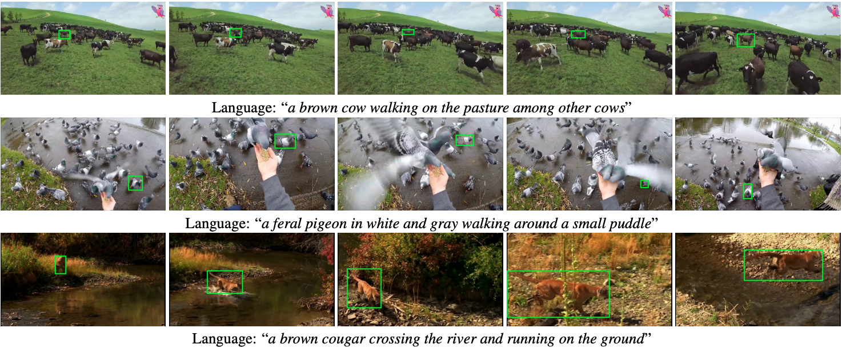
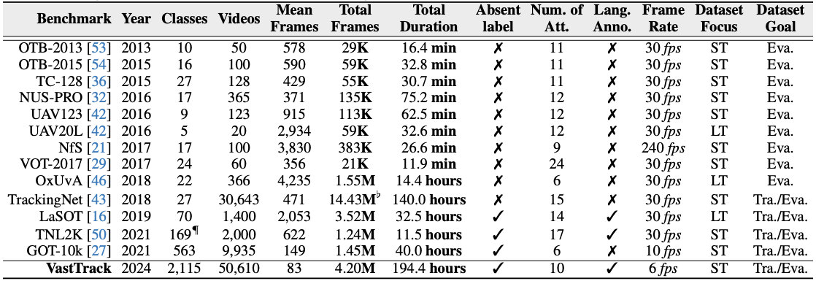
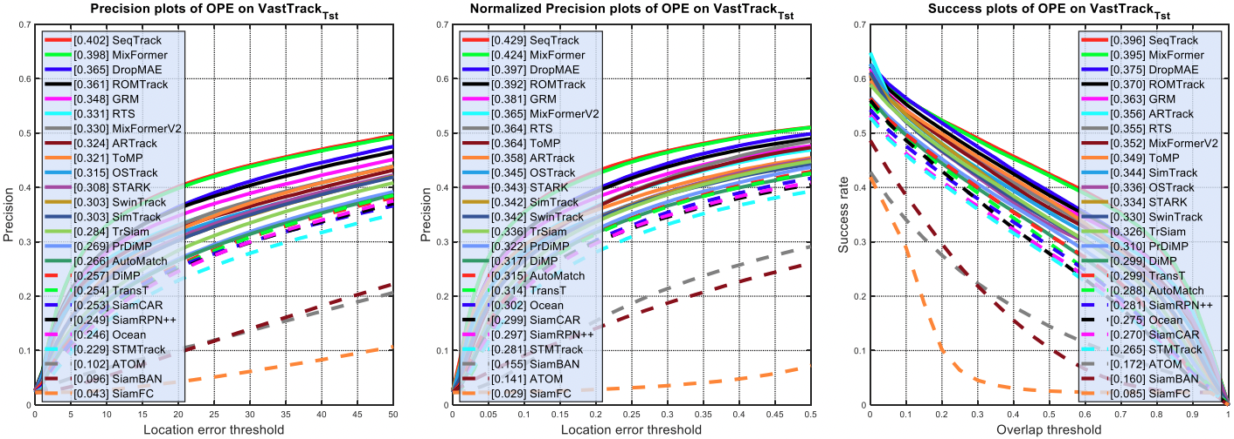
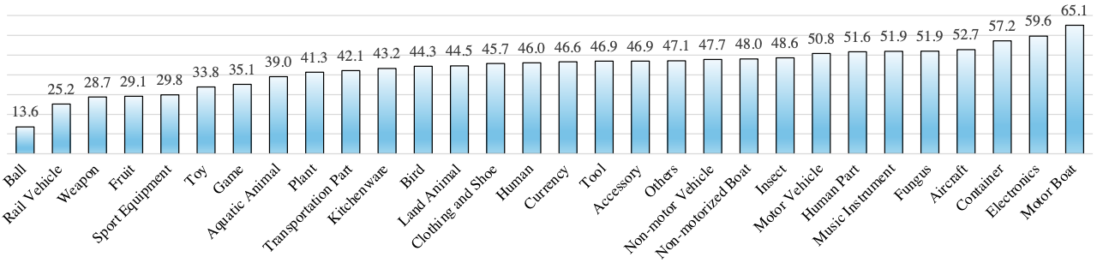
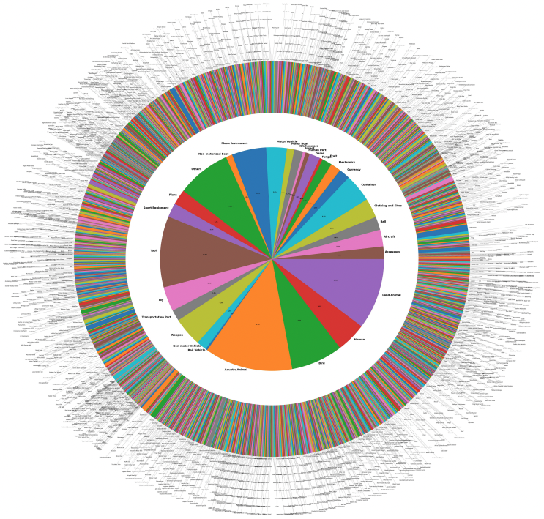
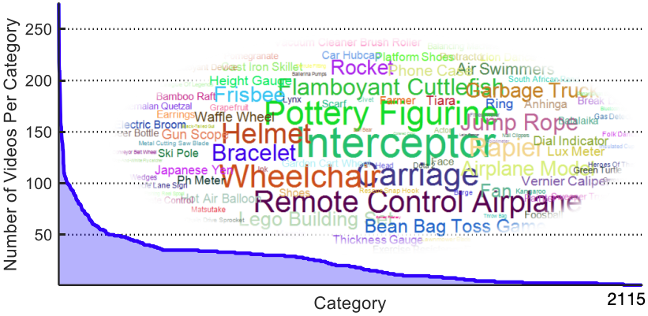
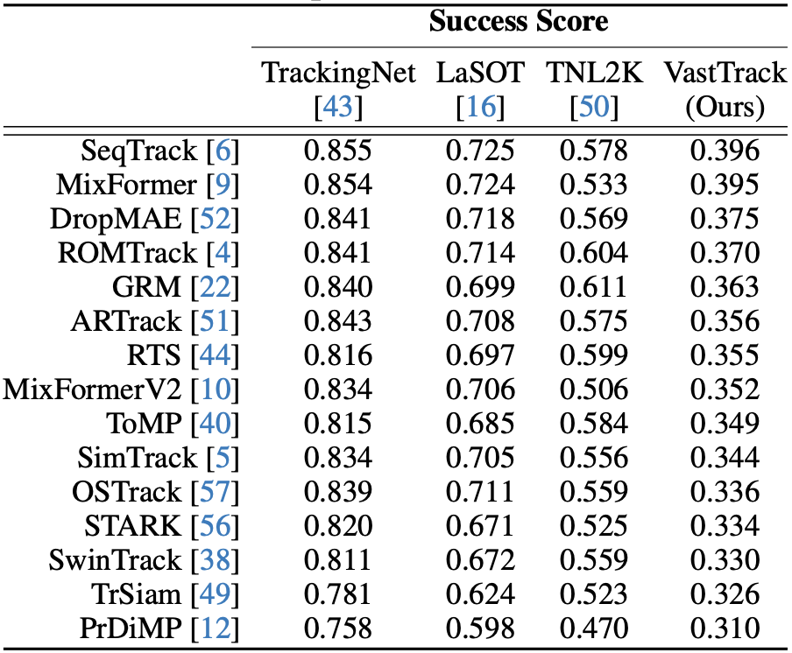
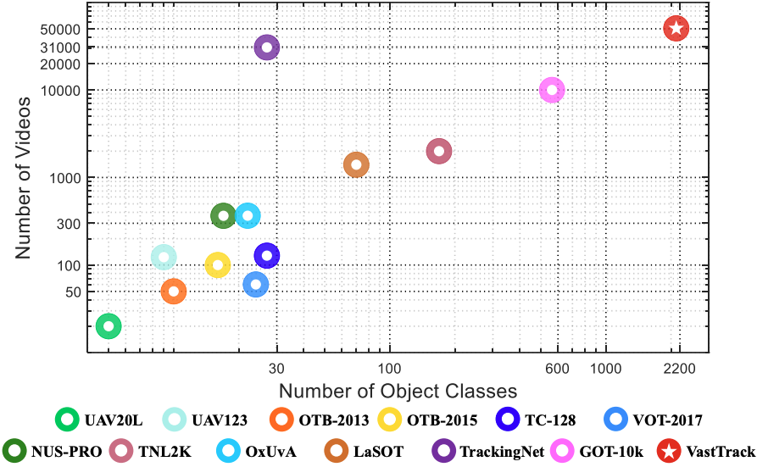
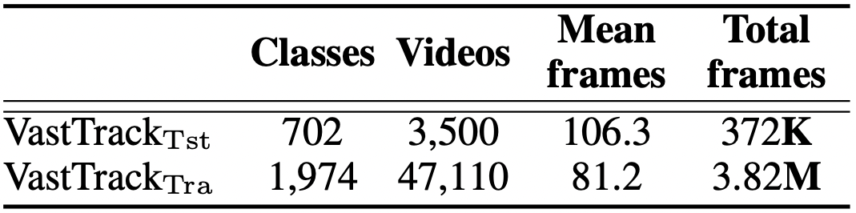

VastTrack: Vast Category Visual Object Tracking
Liang Peng¹* Junyuan Gao¹* Xinran Liu^{1,2}* Weihong Li¹* Shaohua Dong³* Zhipeng Zhang⁴ Heng Fan^{3†} Libo Zhang^{1†} (*equal contributions; †equal advising and co-last author)
¹Institute of Software Chinese Academy of Sciences ²University of Chinese Academy of Sciences ³UNT ⁴KargoBot
Introduction
Proposed VastTrack
Experiments
Evaluation of 25 state-of-the-art-trackers using precision, normalized precision and success scores.
We propose VastTrack, the largest tracking benchmark regarding the number of videos and object categories.
We offer high-quality comprehensive labeling, including bounding box annotation and natural language description for each video.
We evaluate 25 state-of-the-art visual trackers on VastTrack, providing extensive baselines for future comparisons.
Comparison on meta classes using success score
VastTrack
Comparison of VastTrack with other datasets
Motivation
Vast Object Category: VastTrack covers targets from 2,115 categories, significantly surpassing classes of existing benchmarks (e.g., GOT-10k with 563 classes and LaSOT with 70 categories). It is the richest dataset to date.
Larger scale: VastTrack offers 50,610 videos with 4.2 million frames, which makes it the largest and the most diverse tracking dataset in terms of the numbers of videos and targets compared to existing datasets.
Rich and Precise Annotations: VastTrack offers both standard bounding box annotations and rich linguistic specifications for videos, and thus enables exploration of both vision-only and vision-language tracking.
Dataset Split and Evaluation Protocol
Limitations of existing tracking benchmarks
Training: 47,110 sequences of VastTrack are used for training.
Test: 3,500 videos are employed for evaluation.
Conclusion
Restricted number of categories
Limited scale for training generic trackers
Small number of natural language descriptions
We propose a new large-scale dataset VastTrack for vast category tracking
Our experiments show that there is still a long way for generic tracking
Evaluation Protocol: We utilize a hybrid protocol wherein part of object classes (not videos) in test set have overlap with training set, while the rest classes remains unseen.

